Slide 1
VIDEO IN A NUTSHELL

Slide 2
OBJECTIVE
In today’s scenario people are so busy in their lives that they are not getting time for themselves and it becomes an absolute need to manage it in the most efficient way possible.
This projects solely aims to solve one such problem. It has become quite a common problem finding it hard to find time to go through lengthy videos of lectures, speeches and long podcasts, we would always wish if there was someone who could provide all these abundant information in a crisp nutshell.

Slide 3
WORKING
Video
Audio
Summary
Transcript

Slide 4
TECHNOLOGIES USED
Deep Learning
Natural Language Processing
Pre-trained Transfer Model
Hugging face transformers – API
Flask module (for web app)

Slide 5
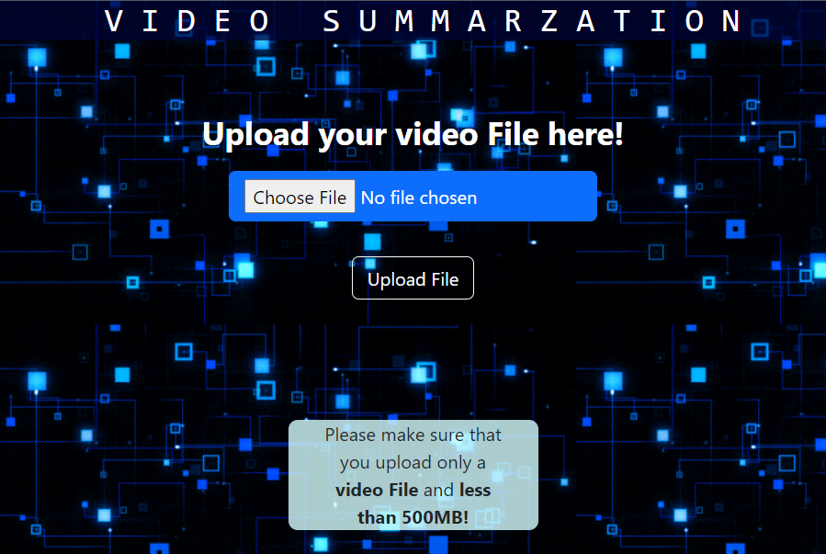
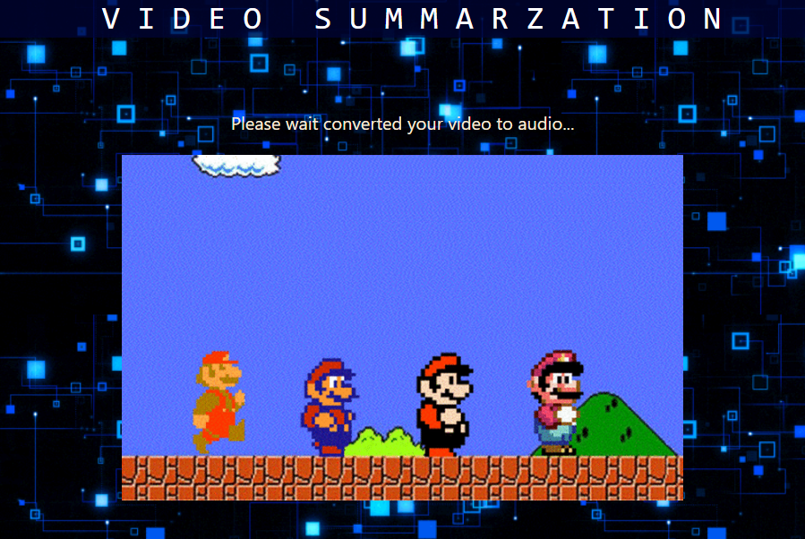
SCREENSHOTS

Slide 6
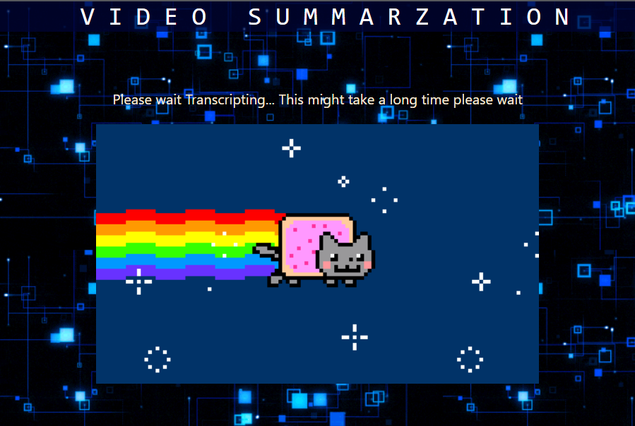
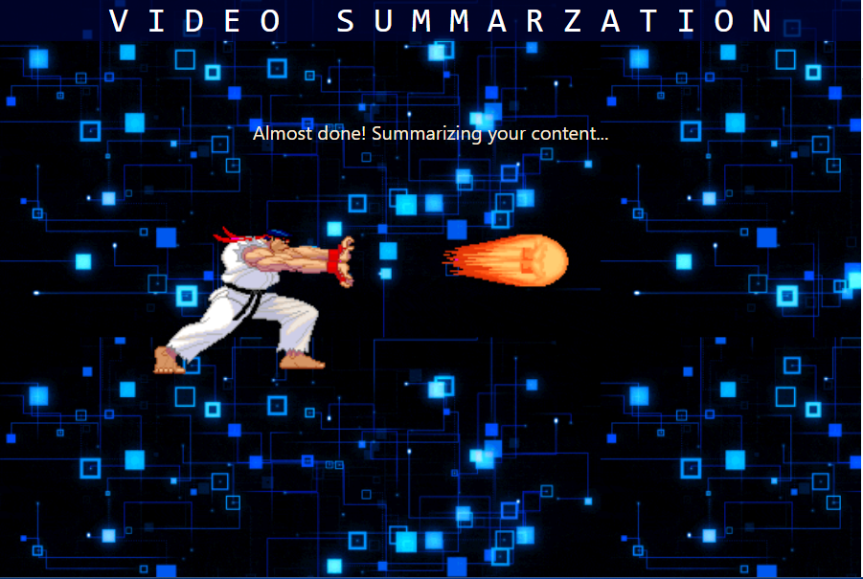
SCREENSHOTS

Slide 7
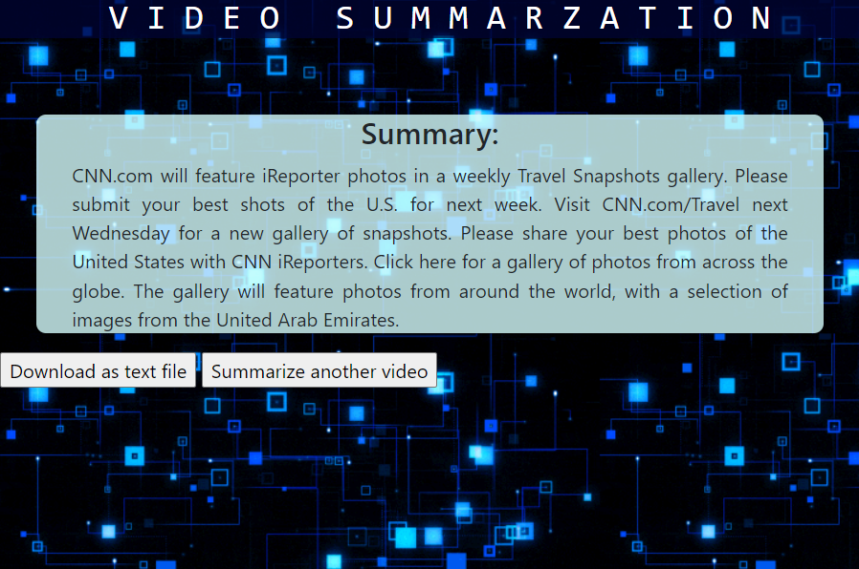
SCREENSHOTS

Slide 8
APPLICATIONS
Condense lecture
Outline a news report
Summing up important points in meeting
Recap a long video

Slide 9
AREAS TO IMPROVE
This app currently runs on a local server. Making it not accessible for everyone, it would definitely be better if we could deploy it in cloud.
For any machine learning application it is important to have best accuracy, this being an early idea and is further under development and have a lot of fine-tuning to do in future.
Speed is a important factor in any application, Transcription takes time according to the model we use.

Slide 10
References
Live Speech to Text with Watson Speech to Text - Nicholas Renotte
Upload Files with Flask Python WTForms – Arpan Neupane
Hugging Face Transformers (Facebook-bart-Large-cnn) API

